Slide 1
Quantum Error Correction methods using Qiskit
Rajesh Sathya Kumar

Slide 2
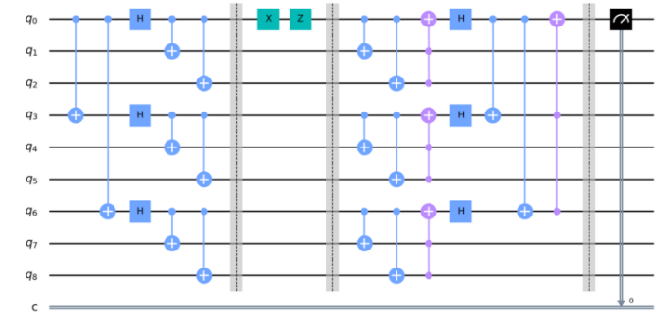
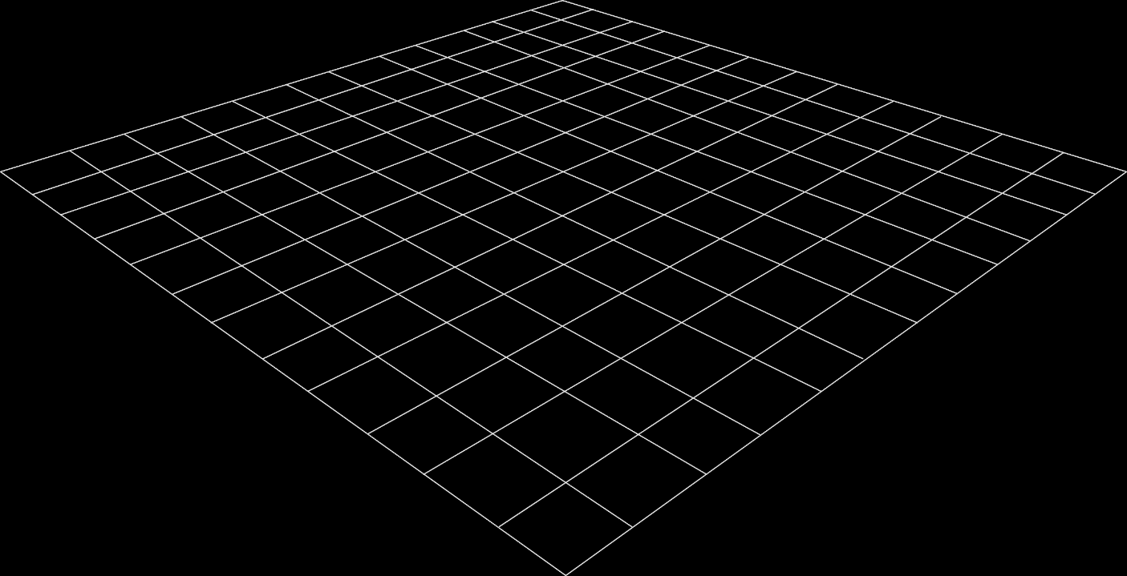
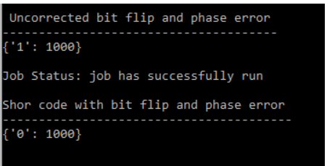
Shor Code: Circuit
Last Week, I was working on implementation of bit flip error correction codes.
Shor code is used in error correction of both the bit flip errors and phase flip errors.
I have shown the circuit for the implementation of the same.
After Correction:

Slide 3
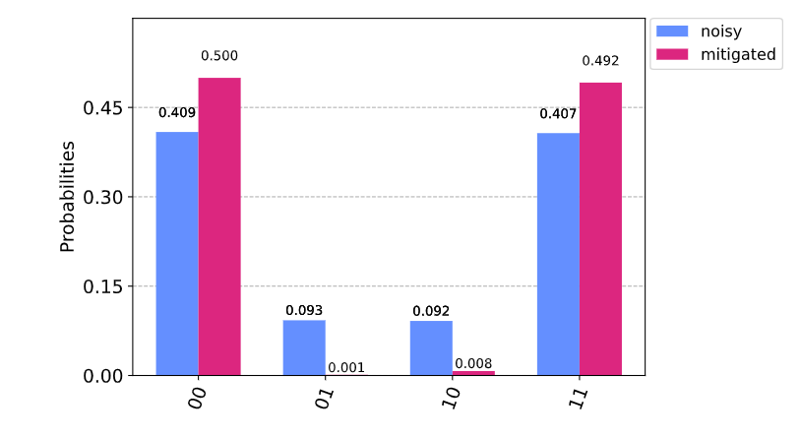
Quantum Measurement Error Mitigation
Execution Specs: QASM Simulator Noise Model: 1% single qubit error
2 Qubits Qiskit API: complete_meas_cal, CompleteMeasFitter

Slide 4
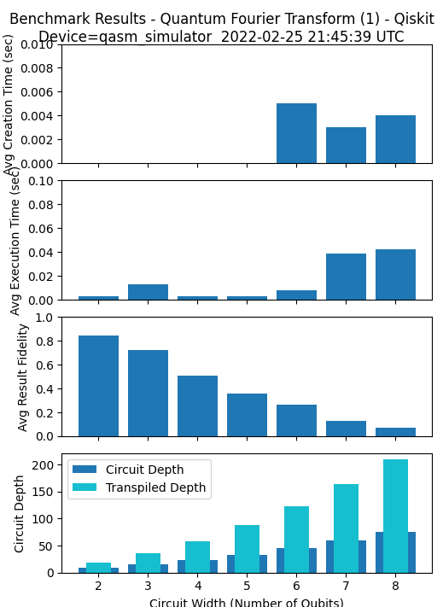
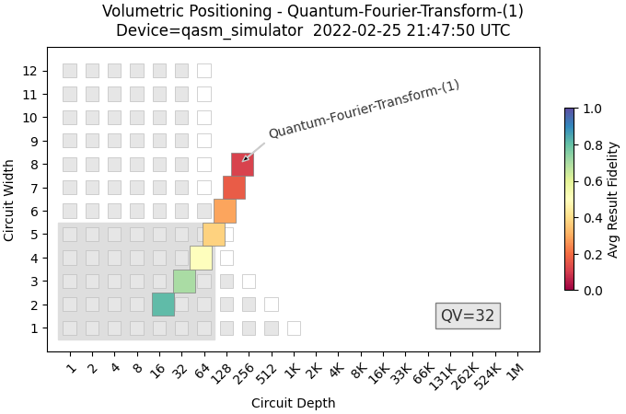
QFT Simulations - Qiskit
With Noise model:
Single Qubit Depolarization Error: 0.3%
Two Qubit Error: 3%
Shots = 100

Slide 5
Metrics
Creation Time: Time spent on classical machine creating the circuit and transpiling.
Execution Time:
Time spent on quantum simulator or hardware backend running the circuit. This only includes the time when the algorithm is being run and does not include any of the time waiting in a queue on Qiskit and cinq.
Fidelity:
A measure of how well the simulator or hardware runs a particular benchmark, on a scale from 0 to 1, with 0 being a completely useless result and 1 being perfect execution of the algorithm.
Circuit / Transpiled Depth:
Depth can be used to help provide reasoning for why one algorithm is harder to run than another for the same circuit width. This metric is currently only available on the Qiskit implementation of the algorithms.

Slide 6
References
https://en.wikipedia.org/wiki/Quantum_error_correction#Shor_code
Quantum Error Correction: An Introductory Guide: https://arxiv.org/pdf/1907.11157.pdf
Measurement Error Mitigation: https://qiskit.org/textbook/ch-quantum-hardware/measurement-error-mitigation.html
Shor Code Error Correction: https://quantumcomputinguk.org/tutorials/quantum-error-correction-shor-code-in-qiskit

Slide 7
Progress
This Week
Implementation of Shor error correction codes
Measurement Error Mitigation
Published some QC metrics to the python library
Plans for Next Week
Validate how the Quantum Algorithms quantify with the metrics after error correction

